Slide 1
AVL TREE

Slide 2
AVL Tree Rotations
In AVL tree, after performing operations like insertion and deletion we need to check the balance factor of every node in the tree.
If every node satisfies the balance factor condition then we conclude the operation otherwise we must make it balanced.
Whenever the tree becomes imbalanced due to any operation we use rotation operations to make the tree balanced.
Rotation is the process of moving nodes either to left or to right to make the tree balanced.

Slide 3
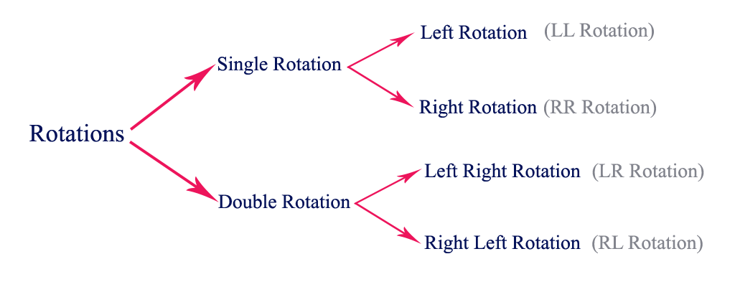
Types of Rotation
There are four rotations and they are classified into two types.

Slide 4
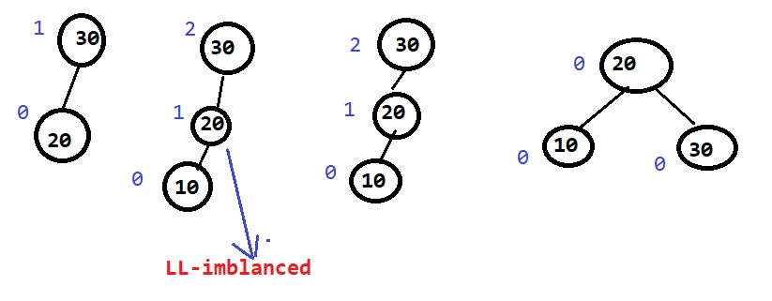
LL Rotation
Also called clock wise rotation .
If you want you can say it is as Right rotation also .
Initial insertion (10) perform LL after LL Rotation

Slide 5
LL Rotation CONT..
Why 30 is Imbalanced ?
Ans : Because of insertion of 10 .
Then in which direction 10 is inserted ?
Ans : Left of Left ( LL )

Slide 6
LL Rotation CONT..
Questions In your Mind :
Qn :You may think that I have taken just a small tree with just 3 nodes , what should I do if the tree is very big
Ans : Don’t worry , rotation are always done with 3 root nodes only

Slide 7
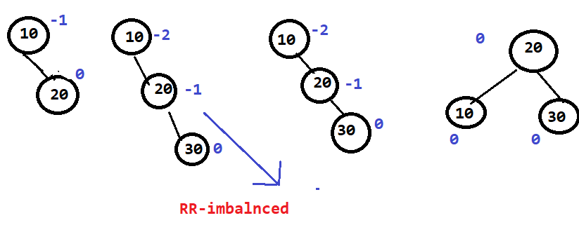
RR Rotation
Also called Counter clock wise rotation .
Initial insertion (30) perform RR after LL Rotation

Slide 8
RR Rotation CONT..
Why 10 is Imbalanced ?
Ans : Because of insertion of 30 .
Then in which direction 30 is inserted ?
Ans : Right side Right (RR)

Slide 9
RR Rotation CONT..
Questions In your Mind :
Qn :We found both RR and LL rotation output same .
Ans : Yes , in all four Rotation The output is always same .

Slide 10
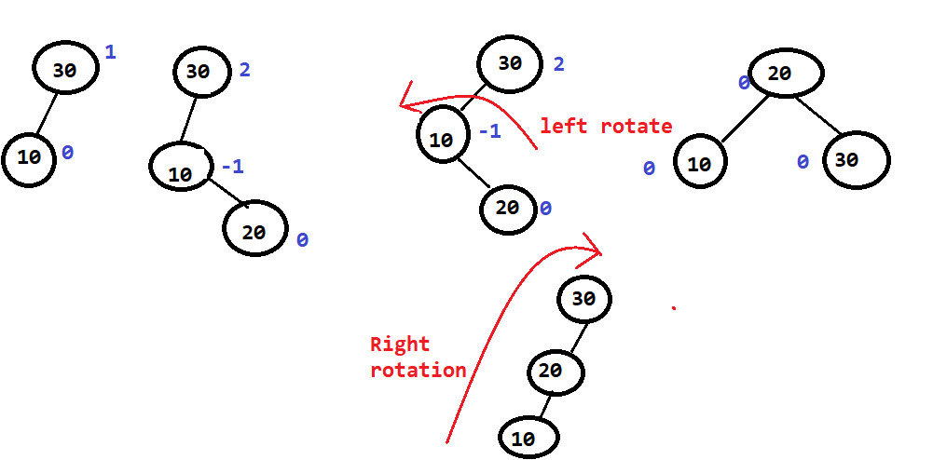
LR Rotation ( Double Rotation )
Initial insertion (20) perform LR after LR Rotation

Slide 11
LR Rotation CONT..
Why it is Imbalanced ?
Ans : Because of insertion of 20 .
Then in which direction 20 is inserted ?
Ans : Left the Right (LR)

Slide 12
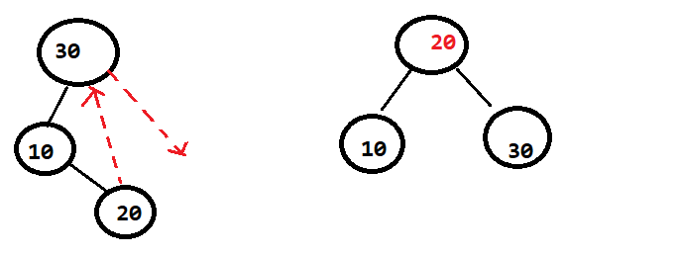
LR Rotation CONT..
Questions In your Mind :
Qn :Sir This Rotation is little bit Complex / complicated ,
Any Shortcut method ??
Ans : Yes

Slide 13
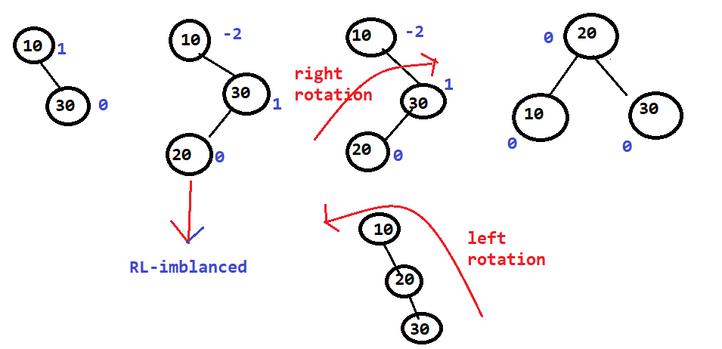
RL Rotation ( Double Rotation )
Initial insertion (20) perform RL after RL Rotation

Slide 14
RL Rotation CONT..
Why it is Imbalanced ?
Ans : Because of insertion of 20
Then in which direction __________is inserted ?
Ans :Right Left

Slide 15
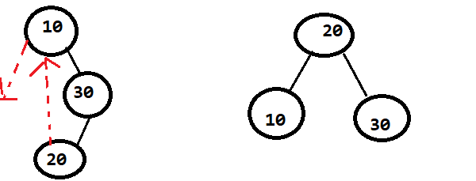
LR Rotation CONT..
Questions In your Mind :
Qn :Sir This Rotation is ALSO little bit Complex / complicated ,
Any Shortcut method ??
Ans : Yes

Slide 16
Out of 4 rotation I will give you one observation (it is helpful)
N= 3
20 30
By using three keys how many different binary tree we can form ?
Ans :

Slide 17
Operations on an AVL Tree
The following operations are performed on AVL tree...
Search
Insertion
Deletion

Slide 18
Search Operation in AVL Tree
In an AVL tree, the search operation is performed with O(log n) time complexity.
The search operation in the AVL tree is similar to the search operation in a Binary search tree.

Slide 19
Search Operation in AVL Tree(cont.)
Step 1 - Read the search element from the user.
Step 2 - Compare the search element with the value of root node in the tree.
Step 3 - If both are matched, then display "Given node is found!!!" and terminate the function .
Step 4 - If both are not matched, then check whether search element is smaller or larger than that node value.

Slide 20
Search Operation in AVL Tree(cont.)
Step 5 - If search element is smaller, then continue the search process in left subtree.
Step 6 - If search element is larger, then continue the search process in right subtree.
Step 7 - Repeat the same until we find the exact element or until the search element is compared with the leaf node.
Step 8 - If we reach to the node having the value equal to the search value, then display "Element is found" and terminate the function.
Step 9 - If we reach to the leaf node and if it is also not matched with the search element, then display "Element is not found" and terminate the function.
.

Slide 21
Insertion Operation in AVL Tree
In an AVL tree, the insertion operation is performed with
O(log n) time complexity.
In AVL Tree, a new node is always inserted as a leaf node. The

Slide 22
Insertion Operation in AVL Tree cont.
Step 1 - Insert the new element into the tree using Binary Search Tree insertion logic.
Step 2 - After insertion, check the Balance Factor of every node.
Step 3 - If the Balance Factor of every node is 0 or 1 or -1 then go for next operation.
Step 4 - If the Balance Factor of any node is other than 0 or 1 or -1 then that tree is said to be imbalanced. In this case, perform suitable Rotation to make it balanced and go for next operation.

Slide 23
Deletion Operation in AVL Tree
The deletion operation in AVL Tree is similar to deletion operation in BST.
But after every deletion operation, we need to check with the Balance Factor condition.
If the tree is balanced after deletion go for next operation otherwise perform suitable rotation to make the tree Balanced

Slide 24
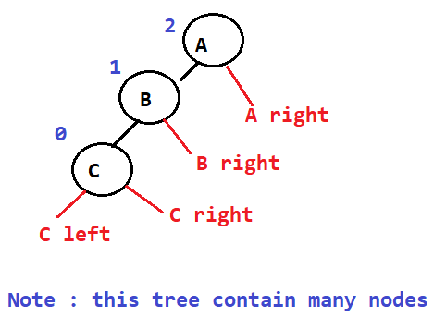
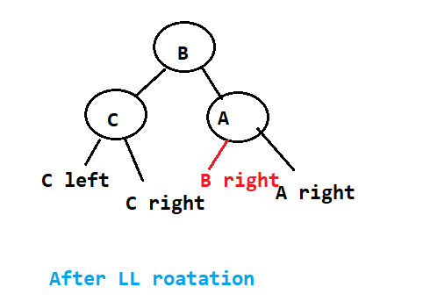
Insertion ( LL rotation )
Questions in your mind:
If there are many nodes in a tree then how rotation will perform

Slide 25
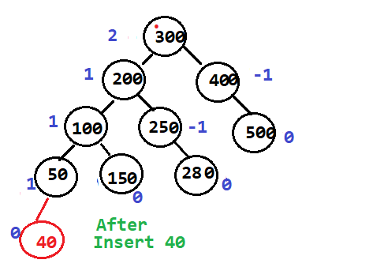
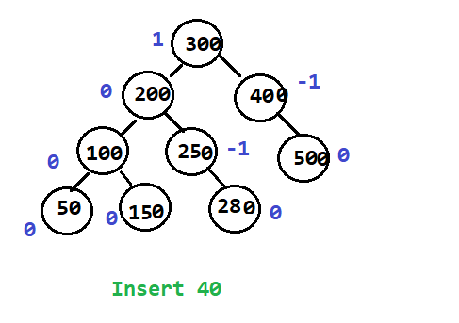
Insertion ( LL rotation ) cont.
EX

Slide 26
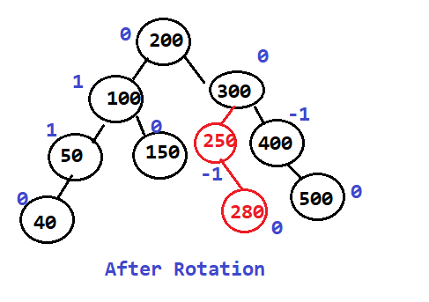
Insertion ( LL rotation ) cont.

Slide 27
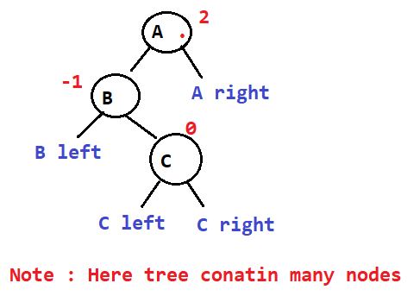
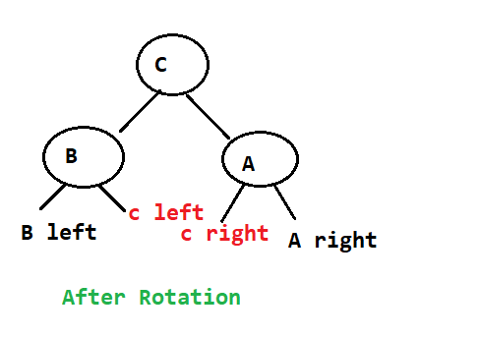
Insertion ( LR rotation )

Slide 28
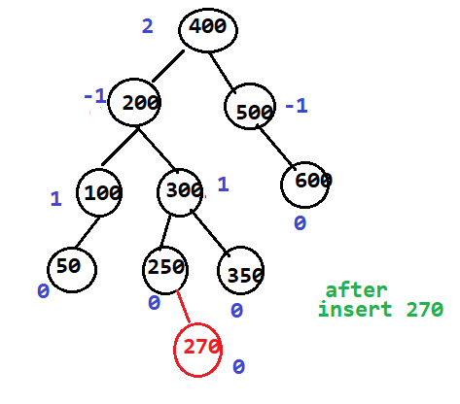
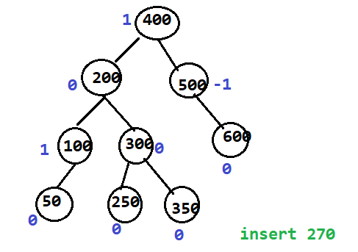
Insertion ( LR rotation )
EX

Slide 29
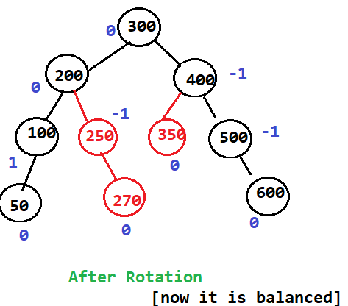
Insertion ( LR rotation ) cont.

